Slide 1
Executive Summary for Specific Topic
Verducatib - Earlier NDA Submission Probability Analysis
Background
PEC Discussion
Rationale for Evaluating Earlier NDA Submission (China)
Current best case NDA submission & approval in China
Why reconsider the timeline now？
Target to enter the same NRDL cycle with HSK31858 (commercial ambition)
Competitive context: The local DPP‑1 inhibitor HSK31858 is expected to get NDA approval before Q1 2028 (~1 year earlier than verducatib under the current plan), which could materially affect pricing leverage and market positioning if verducatib enters NRDL 1y later.
Team Proposal
HSK31858 approval
June 2028
2028 NRDL
June 2029
2029 NRDL
Verducatib
Team proposed the following key results & messages to deliver to key stakeholders (commercial TA, LRR etc):
Acceleration of NDA submission is conditionally possible and requires explicit documentation of assumptions and risks. (Re-visits should be considered following each milestones.)
The PoS (Probability of Success) of NDA approval in China in June 2028 is low.
Dec 2027
NDA submission
Dec 2028
NDA Approval
Request for PEC
Seek PEC advice on the assessment results and stakeholder communication message/plan.
□ For Sharing √ For Advice □ For Endorsement

Slide 2
The Under-Assessment Acceleration in the Best Case NDA Submission Timeline
Adolescent recruitment expectation: ~40 (~16 complete study) (still a potential risk for HA)
Trigger NRDL Negotiation in 2028 and DRDL listing in 2029
Oct 29, 2027
DBL(1)
Jul 26, 2027
TLR
05 Aug 2027
BTD Feedback
Oct 2027
Accelerated:
NDA Submission
Oct 2027
Best case:
NDA Submission
Dec 2027
Accelerated:
NDA Approval
June 2028
Best case NDA Approval
Dec 2028
BTD sub.
Aug 2027
Pre-NDA (PR) Feedback
Oct 2027
CTP 3.0 - event-driven DBL (tbd) may delay the planned DBL(1).
(needs close monitoring and dynamic evaluation)
China pre-NDA (PR) sub.
Aug 2027
China submission
US submission
EU submission
NDA submission in Oct 2027 is a shared goal for US/EU, and China.
The evaluation was well aligned with global clinical development team (evidence team).
Notes:
*Process Performance Qualification

Slide 3
Critical assumptions for accelerated best case
Submission on 29 Oct 2027
LPO on 01Jul2027, DBL on 26Jul2027, TLR on 05Aug2027
CMC DS PPQ completion on 25Sep2027 without unexpected analytical results
PR confirmed in Oct 2027 via pre-NDA (30WD for pediatric case)，based on data from ~40 adolescents (75 planned for the trial).
Whole dossier ready on 15 Oct 2027 in CN and EN
eCTD publication in one week (vs standard 10WD)
Resource should be prioritized and sticked
Approval by end of Jun 2028
      Approval in 8M (vs current benchmark for NDA approval with PR is 12M) including
      QC testing
      ad hoc panel meeting
      potential GMP inspection (if CN progress faster than US)
      Fast negotiation for approval documents
DS PPQ=drug substance process performance qualification.

Slide 4
Acceleration of verducatib launch and NRDL entry assessment
Priorities | Current Issues | Target Date | PoS Level | Mitigation Plan/Next actions | Support Requested
DBL (adults)/TLR | Uncertainty in DBL timeline: Events-driven DBL Global LPO→DBL | Jul 26, 2027 | Medium | Keep monitoring the number of events and update risk level accordingly | NA
Adolescent recruitment | Challenge in adolescent recruitment: Small patient size for recruitment (protocol required 75 adolescents) Adolescent data is critical for PR application | Jul 26, 2027 | Low-Medium | Internal assessment of ~40 patient data to support China PR. Accelerate adolescent recruitment. | Global (+local) acceleration plan for adolescent recruitment Interim analysis plan to be decided to support PR/BTD.
Clinical& CMC Dossier Readiness | Tight timeline for NDA dossier readiness timeline (Oct 15, 2027 is a critical cutoff date for all document readiness for submission) Clinical: CTR&SGAR，CO CMC: DS PPQ report & S250 No buffer to address country specific needs in LPI before submission | Oct 15, 2027 | Medium-High | Frontloading package preparation, esp CMC/SGAR documents. Early involved CN team into core documents draft flow | Global support for in-parallel preparation of NDA documents (authoring, translation, proofreading, review, etc).
BTD | CDE discouraged BI to further apply for BTD China subgroup efficacy/safety profile needs to be 'superior' to HSK31858 | Aug 2027 | Low | NA | NA
PR | Need solid evidence to extrapolate efficacy in adults to adols. Need adequate adol data to support PR | Aug 2027 | Medium | Internal assessment of ~40 patient data to support China PR. Accelerate adolescent recruitment | Global (+local) acceleration plan for adol. To accumulate more evidence in adolescents
NDA Approval in June 2028 | Medium risk for PR High risk for 8-month NDA review timeline even under PR | June 2028 | Low | Local team to manage all controllables: QC sample readiness, GCP inspection, timeline which could impact NDA approval timeline; | Seamless planning and collaboration among x-functional teams.
DS PPQ=drug substance process performance qualification; SGAR=subgroup analysis report; PoS=Probability of Success
Notes:
Process Validation: General Principles and Practices

Slide 5
Next actions (next 2–4 weeks)
Actions | Deliverables | Due | Owner
Confirm adol recruitment acceleration plan; lock sites/KPIs and resourcing | Acceleration plan v1 | Within 2 weeks | ET / Global ClinOps / Local
Align interim analysis framework and go/no-go checkpoints for PR/BTD + NDA | Interim analysis decision memo | Within 2 weeks | Global Stats / Clin Dev
Complete China-specific TLR subgroup analysis; include in next TLR batch | China subgroup pack + conclusion | Within 3 weeks | Global Clin Dev / Biometrics
Finalize BTD/PR path and package checklist (incl. BB frontloading) | Strategy decision + checklist/RACI | Within 3 weeks | Global Reg / Clin Dev
Stand up parallel NDA doc tracker for CMC + China clinical docs; confirm critical path | NDA tracker + gated timeline | Within 4 weeks | Global Reg Ops / CMC / Local RA
Map QC readiness and GCP inspection risks impacting NDA approval; define mitigations | QC/GCP risk log + mitigations | Within 4 weeks | Local QA/QC / ET
DS PPQ=drug substance process performance qualification; SGAR=subgroup analysis report

Slide 6
Summary & Discussion
Acceleration assessment in the best-case NDA submission is a shared effort across local and global clinical development teams.
NDA submission in Oct 2027 (2 months earlier) is conditionally possible based on local and global joint evaluation with the following risks to note:
  DBL delay (events-driven DBL, LPO→DBL timeline).
  HA feedback on BTD/PR.
  Critical document readiness (Critical CMC document: DS PPQ; Critical clinical document: SGAR).
PoS of NDA approval in June 2028 is considered as low, given the critical challenges below:
  Uncertainty in PR/BTD
  The 8-month NDA review timeline for verducatib under PR is below industry benchmark.
Next step actions (see next slide for detailed plan):
  Closely work with global team for breakdown document preparation
  Local NDA kickoff in June and report back to PEC for NDA strategy endorsement (June/Jul 2026).
DS PPQ=drug substance process performance qualification; SGAR=subgroup analysis report

Slide 7
Back up

Slide 8
For pre-reads ONLY
Global DRAFT NDA Submission Timeline as of April 2026
Sep 17 - Oct 12
Adolescent recruitment expectation: ~40 (~16 complete study) (still a potential risk for HA)
CO
25 days
CO 2nd draft out
Oct 1
SCE final
Oct 5
CO final version
Oct 12
LPO
DBL
approx. TLR
CO 1st draft out
Start compilation
Jul 1
Jul 26
Aug 5
Sep 17
Oct 15
Jul
Aug
Sep
Oct
Nov
Dec
2027
Aug 24
Sep 21
Oct 5
CTP 3.0 - event-driven DBL may delay the planned DBL(1).
(needs close monitoring and dynamic evaluation)
CTR STATANA
CTR 2nd draft out
SCF final
Sep 8
Sep 30
CTR 1st draft out
CTR content final
Aug 24 - Sep 30
CTR
37 days
China SGAR* (CN version only)
Oct 20 - Oct 29
USA Submission
9 days
Oct 20 - Oct 29
CN Submission
9 days
Oct 20 - Oct 29
EU Submission
9 days
Dec 1 - Dec 21
* SGAR=Sub-Group Analysis Report
JP Submission
20 days
Oct 15, 2027
Notes:
On global side:
All submission-relevant analyses and results are finalized and available on time, with no open scientific concerns. No pooling or late revised decision.
Front loading most of the documents. Core submission documents are review-ready before 2nd draft.
No unexpected analytical results in DS PPQ (unreleased data expected to be only available by 25 Sep 27) / or failure in DS synthesis steps.
The current clinical development timeline from LPO to DBL is 6 weeks (vs 4 weeks for current best target) for pivotal phase III trials. The team is looking into all possibilities in order support early submission. Furthermore, the site resources will also be an important factor influencing this timeline due to the high amount of data to be cleaned in a shorter time.
Submission work prioritized over other activities.
China Team additional:
CN subgroup TLR ready on time to support pre-NDA interaction and BTD in Aug. ​
CN subgroup data available on time –in one week after entire data available or earlier if possible ​
Whole dossier ready by 15 Oct 2027 in both EN and CN​
Ø ​Pre-block review time slot for CN specific documents, including China RMP, SGAR, CMC docs (CNTS, TMP), etc.​
Ø Prepare CN labeling in paralleled and aligned with CCDS​, no buffer to address country specific needs before submission
Ø Prepare 1397-0014 SGRA in parallel with CTR, review and translate based on mock document and fill in CN results in Chinese version only (MW will coordinate further with BDS). ​
Ø LRA request to involv

Slide 9
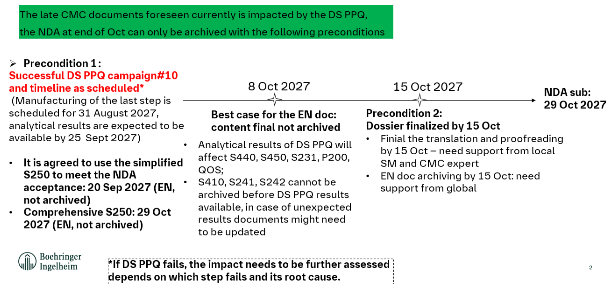
Critical CMC document to support the accelerated NDA submission
For pre-reads ONLY
DS PPQ=drug substance process performance qualification; SGAR=subgroup analysis report
Notes:
On global side:
All submission-relevant analyses and results are finalized and available on time, with no open scientific concerns. No pooling or late revised decision.
Front loading most of the documents. Core submission documents are review-ready before 2nd draft.
No unexpected analytical results in DS PPQ (unreleased data expected to be only available by 25 Sep 27) / or failure in DS synthesis steps.
The current clinical development timeline from LPO to DBL is 6 weeks (vs 4 weeks for current best target) for pivotal phase III trials. The team is looking into all possibilities in order support early submission. Furthermore, the site resources will also be an important factor influencing this timeline due to the high amount of data to be cleaned in a shorter time.
Submission work prioritized over other activities.
China Team additional:
CN subgroup TLR ready on time to support pre-NDA interaction and BTD in Aug. ​
CN subgroup data available on time –in one week after entire data available or earlier if possible ​
Whole dossier ready by 15 Oct 2027 in both EN and CN​
Ø ​Pre-block review time slot for CN specific documents, including China RMP, SGAR, CMC docs (CNTS, TMP), etc.​
Ø Prepare CN labeling in paralleled and aligned with CCDS​, no buffer to address country specific needs before submission
Ø Prepare 1397-0014 SGRA in parallel with CTR, review and translate based on mock document and fill in CN results in Chinese version only (MW will coordinate further with BDS). ​
Ø LRA request to involv

Slide 10
Critical Assumptions for NDA Approval in June 2028
Number | Key assumptions | Note
Assumption #1 | TLR available in Aug 2027.
Assumption #2 | PR is granted based on data from ~40 adolescents (75 planned for the trial).
Assumption #3 | NDA dossier ready for submission by Oct 15, 2027.
Assumption #4 | NDA review under PR will be completed within 8 months.

Slide 11
PR is granted based on data from ~40 adolescents (1/2)
Cutoff Date: Apr 17, 2026 | Global Recruitment Status |  | Mainland China Recruitment Status
 | Planned | Actual | Planned | Actual
No. of screening -adults | 2400 | 1112 | 268 | 214
No. of randomization-adults | 1680 | 1588 | 201 | 242
Screen failure-adults | 720 | 130 (12.6%) | 67 | 35 (16.4%)
No. of screening -adols | 100 | 11 | 5 | 0
No. of randomization-adols | 75 | 2 | 2 | 0
Prevalence of BE (NCF) in adolesscents could be as low as 0.2/100k
  ~19/100k (CF + NCF) in the US
  The data in China is unavailable

Slide 12
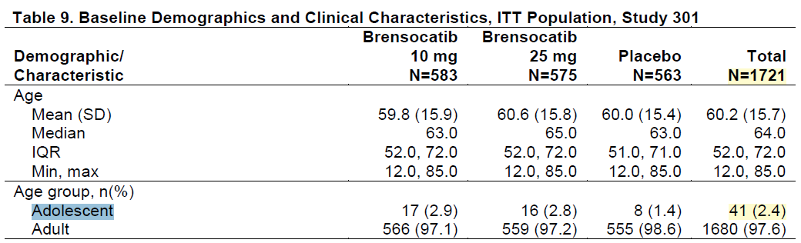
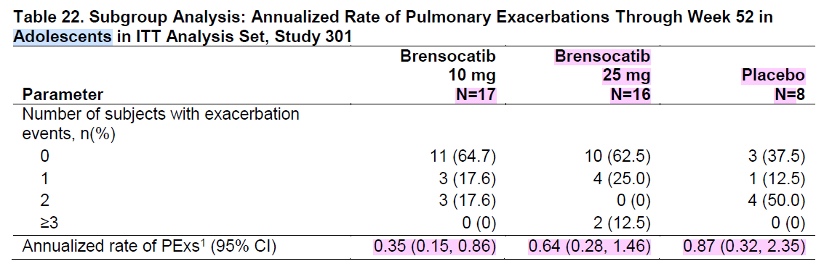
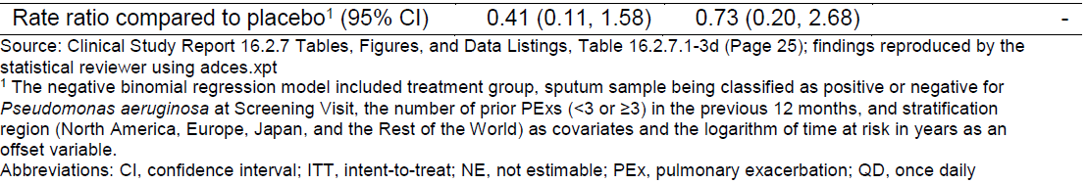
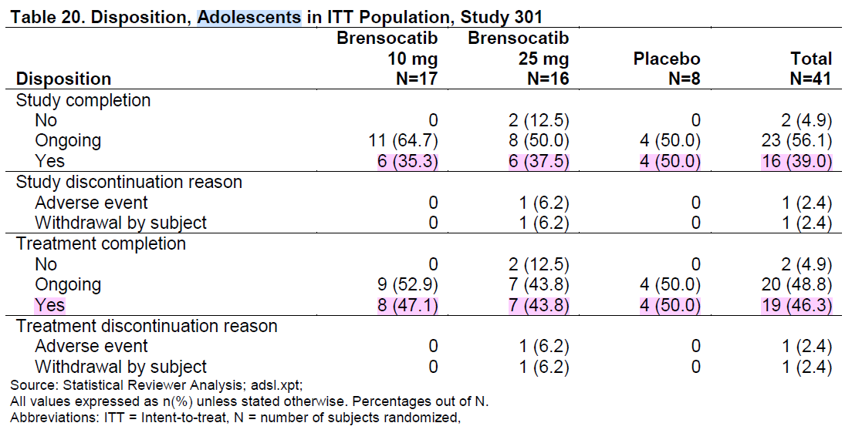
PR is granted based on data from ~40 adolescents (2/2)
~40 adols randomized by DBL in Jul 2027
  External experience (brensocatib FDA approval)
  Internal assessment from statistical & operational perspective

